Slide 1

Capstone Project Phase b Algorithms for generating permutations
(22-2-r-3)
SUBMITTERS:
Yaniv Idov
Omri Cohen
SUPERVISOR:
Prof. Shmuel Zaks

Slide 2
Introduction
A permutation is a mathematical technique that determines the number of possible arrangements in a set when the order of the arrangements matters
The number of permutations of n distinct objects is n factorial, usually written as n!
Permutations are used in almost every branch of mathematics, and in many other fields of science:
In computer science – they are used for analyzing sorting algorithms
In quantum physics - for describing states of particles
In biology - for describing RNA sequences
2

Slide 3
Our goal in phase B of the project is to research and implement variety of algorithms that generate all permutations and compare their runtime complexity
Generation example
N=3 : 123 , 132 , 312 ,321, 231 ,213
Ranking example
The position of 312 from the previous list is 3.
For each algorithm we will examine:
The generation algorithm
Ranking - The algorithm that gives the position of a given permutation
Unranking - The algorithm that outputs the permutation given its index
Unranking example
The permutation in the 5th place is 231
3

Slide 4
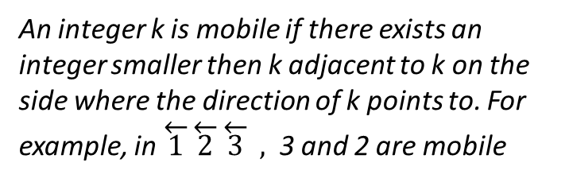
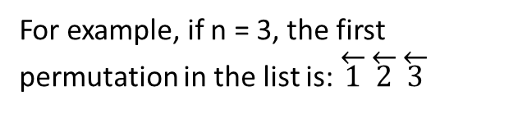
Adjacent transpositions algorithm
Johnson and Trotter
The way one permutation is changed to the next is by an adjacent transposition
An integer k is mobile if there exists an integer smaller then k adjacent to k on the side where the direction of k points to. For example, in $\overset{←}{1}\overset{←}{2}\overset{←}{3} ,$3 and 2 are mobile
We denote by an arrow above each integer its direction, namely, the direction in which it tends to go
For example, if n = 3, the first permutation in the list is: $\overset{←}{1}\overset{←}{2}\overset{←}{3}$
4

Slide 5

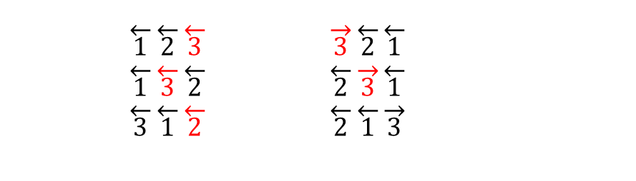
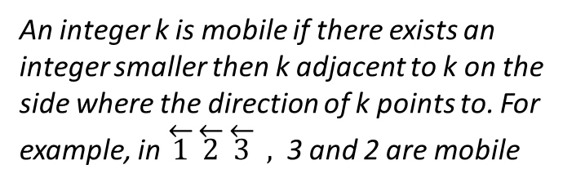

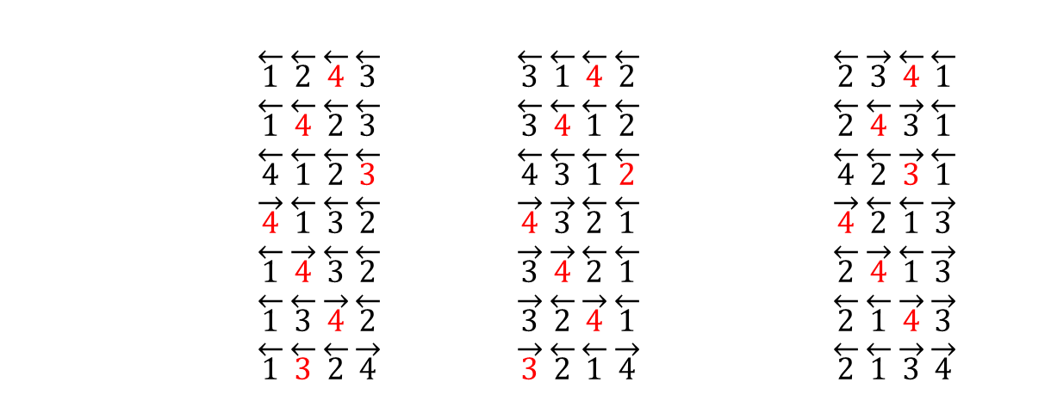
The algorithm to produce the permutations:
1. if there are no mobile integers, stop.
2. call the largest mobile integer m
3. let m switch places with the adjacent integer to which mth direction points to
4. switch the direction of all integers k for which k>m. return to step (1)
An integer k is mobile if there exists an integer smaller then k adjacent to k on the side where the direction of k points to. For example, in $\overset{←}{1}\overset{←}{2}\overset{←}{3} ,$3 and 2 are mobile
N=4:
$$\overset{←}{1}\overset{←}{2}\overset{←}{3}\overset{←}{4} \overset{←}{3}\overset{←}{1}\overset{←}{2}\overset{←}{4} \overset{←}{2}\overset{→}{3}\overset{←}{1}\overset{←}{4}$$
$$\overset{←}{1}\overset{←}{2}\overset{←}{4}\overset{←}{3} \overset{←}{3}\overset{←}{1}\overset{←}{4}\overset{←}{2} \overset{←}{2}\overset{→}{3}\overset{←}{4}\overset{←}{1} \\ \overset{←}{1}\overset{←}{4}\overset{←}{2}\overset{←}{3} \overset{←}{3}\overset{←}{4}\overset{←}{1}\overset{←}{2} \overset{←}{2}\overset{←}{4}\overset{→}{3}\overset{←}{1} \\ \overset{←}{4}\overset{←}{1}\overset{←}{2}\overset{←}{3} \overset{←}{4}\overset{←}{3}\overset{←}{1}\overset{←}{2} \overset{←}{4}\overset{←}{2}\overset{→}{3}\overset{←}{1} \\ \overset{→}{4}\overset{←}{1}\overset{←}{3}\overset{←}{2} \overset{→}{4}\overset{→}{3}\overset{←}{2}\overset{←}{1} \overset{→}{4}\overset{←}{2}\overset{←}{1}\overset{→}{3} \\ \overset{←}{1}\overset{→}{4}\overset{←}{3}\overset{←}{2} \overset{→}{3}\overset{→}{4}\overset{←}{2}\overset{←}{1} \overset{←}{2}\overset{→}{4}\overset{←}{1}\overset{→}{3} \\ \overset{←}{1}\overset{←}{3}\overset{→}{4}\overset{←}{2} \overset{→}{3}\overset{←}{2}\overset{→}{4}\overset{←}{1} \overset{←}{2}\overset{←}{1}\overset{→}{4}\overset{→}{3} \\ \overset{←}{1}\overset{←}{3}\overset{←}{2}\overset{→}{4} \overset{→}{3}\overset{←}{2}\overset{←}{1}\overset{→}{4} \overset{←}{2}\overset{←}{1}\overset{→}{3}\overset{→}{4}$$
N=3:
$$\overset{←}{1}\overset{←}{2}\overset{←}{3} \overset{→}{3}\overset{←}{2}\overset{←}{1} \\ \overset{←}{1}\overset{←}{3}\overset{←}{2} \overset{←}{2}\overset{→}{3}\overset{←}{1} \\ \overset{←}{3}\overset{←}{1}\overset{←}{2} \overset{←}{2}\overset{←}{1}\overset{→}{3}$$
O(n!n)
5

Slide 6
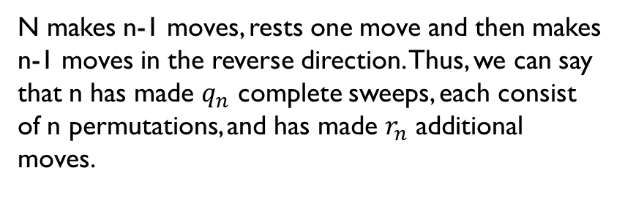

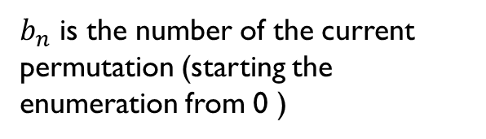



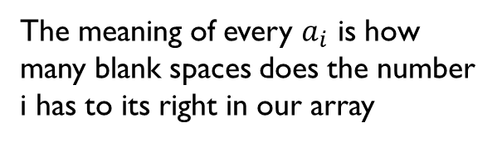
Generating the permutation from the index
N makes n-1 moves, rests one move and then makes n-1 moves in the reverse direction. Thus, we can say that n has made $q_{n}$ complete sweeps, each consist of n permutations, and has made $r_{n}$ additional moves.
Rules we are going to use:
$${1. b}_{n}=nq_{n}+r_{n} , 0≤r_{n}<n$$
$$2. b_{n−1}=q_{n}$$
$$3. a_{i}=$$
$b_{n}$ is the number of the current permutation (starting the enumeration from 0 )
$$r_{i}$$
$if q_{i} is even$
$$i−1−r_{i} if q_{i} is odd$$
The meaning of every $a_{i}$ is how many blank spaces does the number i has to its right in our array
6

Slide 7



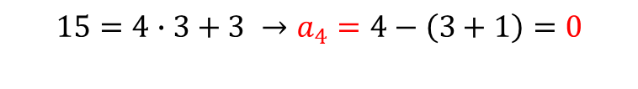



Finding permutation number 15 (the 16th) in the generation for n=4:
Generating the permutation from the index
Rules we are going to use:
$$15=4∙3+3 →a_{4}=4−\left(3+1\right)=0$$
$${1. b}_{n}=nq_{n}+r_{n} , 0≤r_{n}<n$$
$$2. b_{n−1}=q_{n}$$
$$3. a_{i}=$$
$${ b}_{3}=q_{4}$$
$$3=3∙1+0 →a_{3}=3−\left(0+1\right)=2$$
$$r_{i}$$
$if q_{i} is even$
$$i−1−r_{i} if q_{i} is odd$$
$$1=2∙0+1 →a_{2}=1$$
4
3
4
3
2
4
O(n)
3
2
1
4
7

Slide 8




Finding the index from the permutation
3214 -> ${ a}_{4}=0 , a_{3}=2 , a_{2}=1$
Rules we are going to use:
First, $b_{2}=r_{2}=a_{2}$. From there on we find
$$r_{i}=$$
$$and b_{i}=i⋅b_{i−1}+r_{i} for i=3,4,…,n$$
$$b_{2}=r_{2}=a_{2}=1$$
$$r_{3}=3−1−2=0 \\ b_{3}=3∙1+0=3$$
$${ r}_{4} =4−1−0=3 \\ { b}_{4} =4∙3+3= 15$$
$${ a}_{i} if b_{i−1} is even$$
$$i−1−a_{i} if b_{i−1} is odd$$
O(n)
8

Slide 9

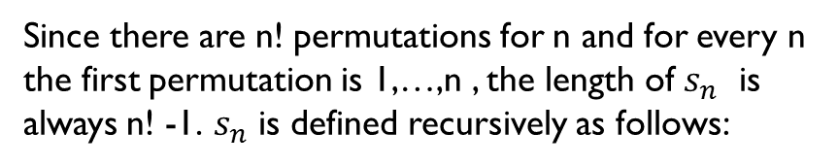
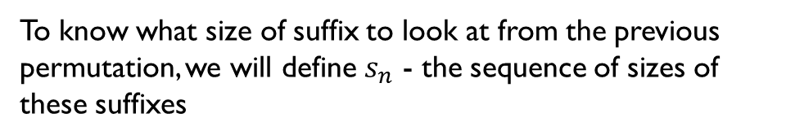
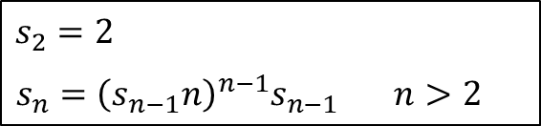
Suffix based algorithm for generation of permutations
Prof. Shmuel Zaks
Unlike many different permutation algorithms in which each step changes the order of 2 adjacent members, in the algorithm we will present to you now, we create permutations by changing a certain suffix of the previous permutation, the size of the suffix we are looking at in each step change, as we will explain later.
To know what size of suffix to look at from the previous permutation, we will define $s_{n}$ - the sequence of sizes of these suffixes
Since there are n! permutations for n and for every n the first permutation is 1,…,n , the length of $s_{n}$ is always n! -1. $s_{n}$ is defined recursively as follows:
$$s_{2}=2$$
$s_{n}={\left(s_{n−1}n\right)}^{n−1}s_{n−1} n>2$
9

Slide 10
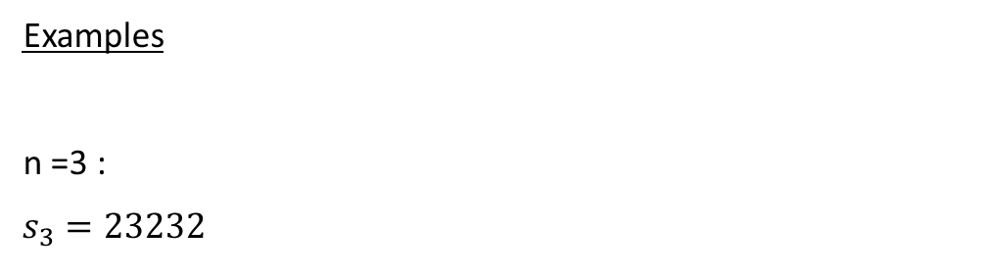

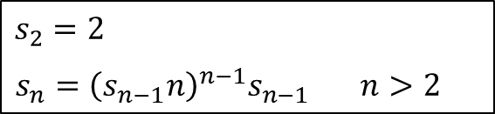
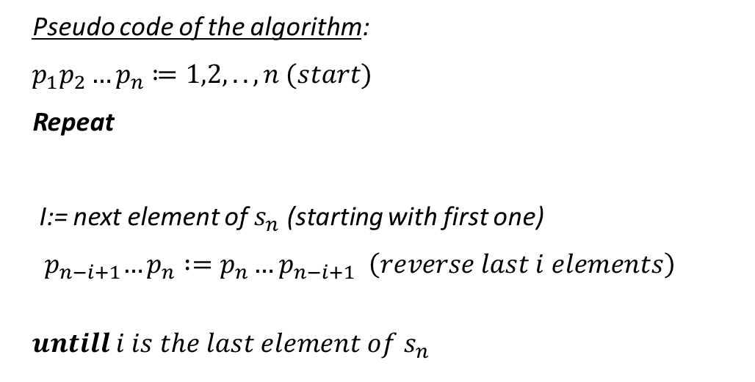
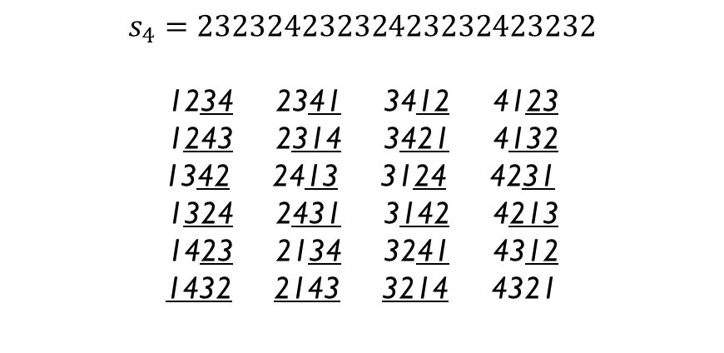
$$s_{2}=2$$
$s_{n}={\left(s_{n−1}n\right)}^{n−1}s_{n−1} n>2$
Examples
n =3 :
$$s_{3}=23232$$
Pseudo code of the algorithm:
$$p_{1}p_{2}…p_{n}≔1,2,..,n (start)$$
Repeat
I:= next element of $s_{n}$ (starting with first one)
$${ p}_{n−i+1}…p_{n} :=p_{n}…p_{n−i+1} \left(reverse last i elements\right)$$
$$untill i is the last element of s_{n}$$
123 231 312
132 213 321
n =4 :
$$s_{4}=23232423232423232423232$$
1234 2341 3412 4123
1243 2314 3421 4132
1342 2413 3124 4231
1324 2431 3142 4213
1423 2134 3241 4312
1432 2143 3214 4321
Note that a sequence is written as a concatenation of its elements
$$O(n!)$$
10

Slide 11







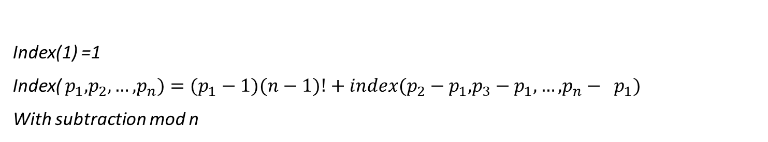









Index(1) =1
Index( $p_{1},p_{2},…,p_{n})=(p_{1}−1)(n−1)!+index(p_{2}−p_{1},p_{3}−p_{1},…,p_{n}− p_{1})$
With subtraction mod n
Index (4321) =$3∙3!+index\left(321\right)$
Index (2413) =$1∙3!+index\left(231\right)$
$$=3∙3!+2∙2!+index\left(21\right)$$
$$=1∙3!+1∙2!+index\left(12\right)$$
$$=3∙3!+2∙2!+1∙1!+index\left(1\right)$$
$$=1∙3!+1∙2!+0∙1!+index\left(1\right)$$
$$=3∙6+4+1+1=24$$
$$=6+2+0+1=9$$
$$Index(4123)=3∙3!+index\left(123\right)$$
Index (3124) =$2∙3!+index\left(231\right)$
$$=3∙3!+0∙2!+index\left(12\right)$$
$$=2∙3!+1∙2!+index\left(12\right)$$
$$=3∙3!+0∙2!+0∙1!+index\left(1\right)$$
$$=2∙3!+1∙2!+0∙1!+index\left(1\right)$$
$$=3∙3!+0∙2!+0∙1! +1=19$$
$$=2∙3!+1∙2!+0∙1! +1=15$$
$$O(n^{2})$$
11

Slide 12
factorial representation
3:4:1:0:1:0! stands for 3₅4₄1₃0₂1₁0₀, whose value is
= 3×5! + 4×4! + 1×3! + 0×2! + 1×1! + 0×0!
= ((((3×5 + 4)×4 + 1)×3 + 0)×2 + 1)×1 + 0
= 463₁₀.
The factorial number system is a mixed radix numeral system: the I - th digit from the right has base i, which means that the digit must be strictly less than i, and that (taking into account the bases of the less significant digits) its value to be multiplied by (i − 1)! (its place value).
463₁₀ can be transformed into a factorial representation by these successive divisions:
From this it follows that the rightmost digit is always 0, the second can be 0 or 1, the third 0, 1 or 2, and so on. The factorial number system is sometimes defined with the 0! place omitted because it is always zero.
463 ÷ 1 = 463, remainder 0
463 ÷ 2 = 231, remainder 1
231 ÷ 3 = 77, remainder 0
77 ÷ 4 = 19, remainder 1
19 ÷ 5 = 3, remainder 4
3 ÷ 6 = 0, remainder 3
12

Slide 13
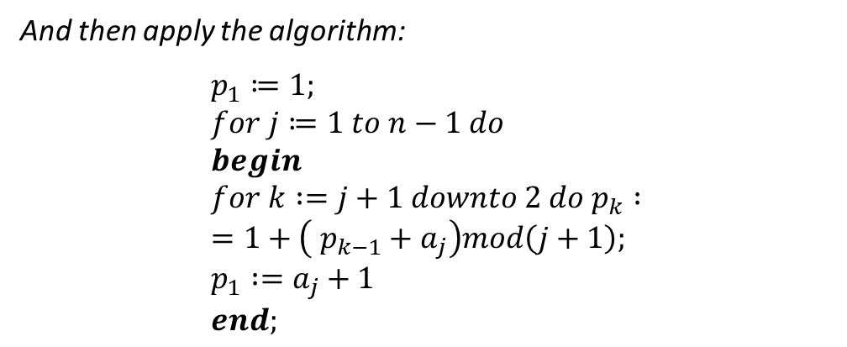
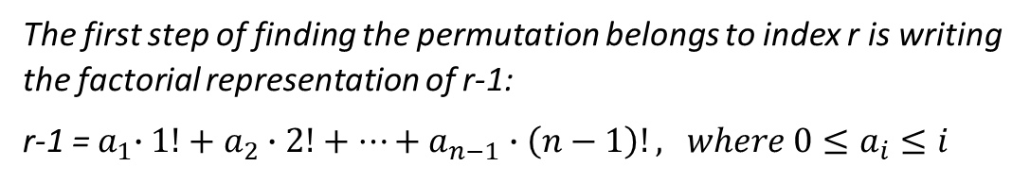

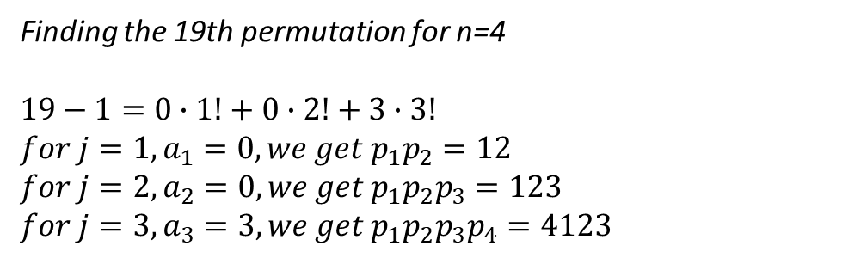
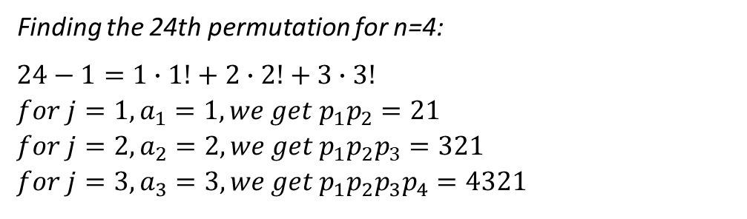
finding the appropriate permutation given the index
Finding the 24th permutation for n=4:
$$24−1=1∙1!+2∙2!+3∙3! \\ for j=1, a_{1}=1, we get p_{1}p_{2}=21 \\ for j=2, a_{2}=2, we get p_{1}p_{2}p_{3}=321 \\ for j=3, a_{3}=3, we get p_{1}p_{2}p_{3}p_{4}=4321$$
The first step of finding the permutation belongs to index r is writing the factorial representation of r-1:
r-1 =${ a}_{1}∙1!+a_{2}∙2!+…+a_{n−1}∙\left(n−1\right)!, where 0≤a_{i}≤i$
And then apply the algorithm:
$$p_{1}≔1; \\ for j≔1 to n−1 do \\ begin \\ for k :=j+1 downto 2 do p_{k} :=1+\left( p_{k−1}+a_{j}\right)mod\left(j+1\right); \\ p_{1} :=a_{j}+1 \\ end;$$
Finding the 19th permutation for n=4
$$19−1=0∙1!+0∙2!+3∙3! \\ for j=1, a_{1}=0, we get p_{1}p_{2}=12 \\ for j=2, a_{2}=0, we get p_{1}p_{2}p_{3}=123 \\ for j=3, a_{3}=3, we get p_{1}p_{2}p_{3}p_{4}=4123$$
$$O(n^{2})$$
13

Slide 14
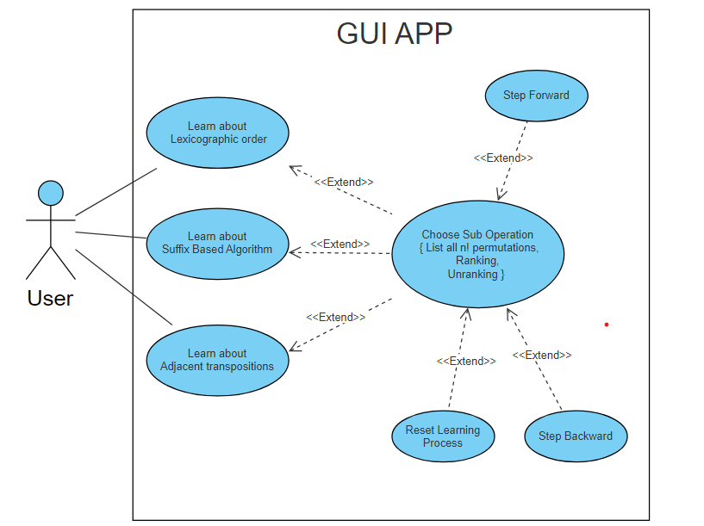
Use Case diagram explaining the GUI APP
14

Slide 15
User Chooses an operation from the menu
Yes
Do you want to continue ?
Start
User enters number of digits in the permutation
List all n! permutations
Unranking
What did the user chose
User enters a number
List al n! permutations
User enters the index he wants
No
Ranking
Does the index he wrote is between 0 to n! -1 ?
Display permutation’s index
No
User enters a permutations
Yes
Display the permutation
End
Flow Chart Diagram – for the implementation of all the algorithms
Start/End
Operation
Selection node
15

Slide 16
Analysis
Creating all n! permutations
16

Slide 17
Analysis
Ranking
17

Slide 18
Analysis
Un-ranking
18

Slide 19

19

